Slide 1
El-Gamal injected Elliptic Curve Cryptography based RFID Authentication for Internet of Medical Things
Supervised by:
Dr. Kazi Md. Rokibul Alam
Professor
Presented By:
Md. Mustafizur Rahman Arman
Roll: 1707083
Dept. of Computer Science and Engineering,
Khulna University of Engineering & Technology, Khulna.

Slide 2
Outline
Introduction
Related Works
Objectives
Required Tools
Proposed Methodology
Prototype Evaluation
Conclusions
Limitations
Future Works
References

Slide 3
Introduction
Internet of Medical things
Mobile
Small memory
Low power
Low-cost cloud computing
Security needed for:
Sensitive medical data
Real-time monitoring
Patient information management

Slide 4
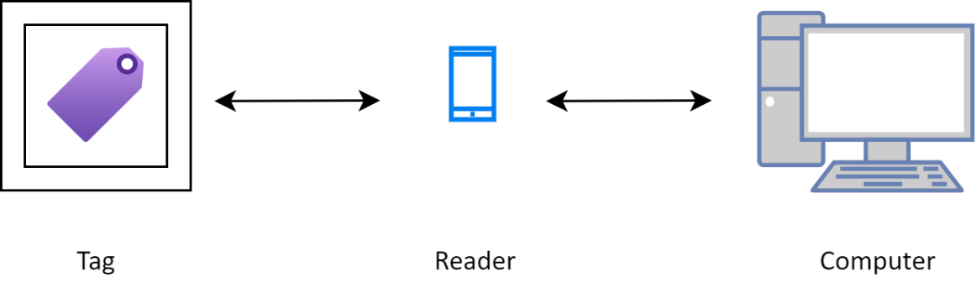
Introduction (Cont.)
Radio Frequency Identification (RFID) [3]
Wireless communication (identify/track)
Component:
RFID Tag: composed of a microchip, an antenna
and a dedicated hardware for cryptographic
operations.
RFID Reader: composed of a radio transmitter,
a radio receiver, a control unit, a memory unit.
Server: Stores all the RFID tag’s identification
information in its database.
Server and Reader works together as they are connected always.
Figure 1: RFID Technology

Slide 5
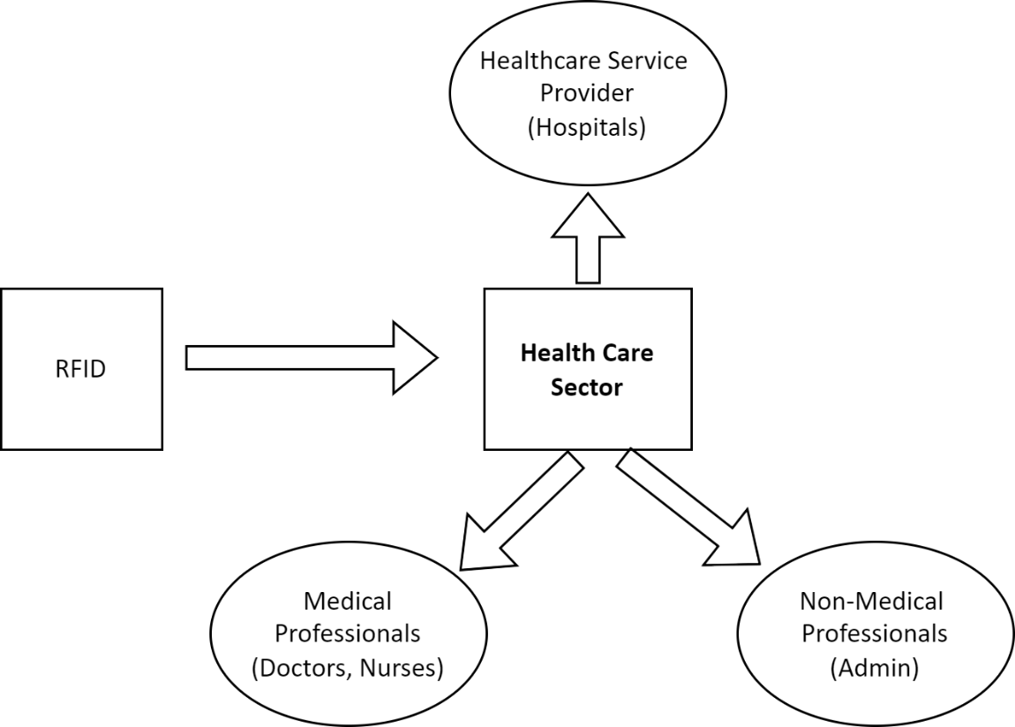
Introduction (Cont.)
Radio Frequency Identification (RFID)
Security Requirements for RFID Communication
Mutual authentication
Confidentiality
Anonymity
Forward security
Availability
Figure 2: A RFID-base healthcare system

Slide 6
Introduction (Cont.)
Difficulties of RFID Authentication
Protection against unwanted access, counterfeiting, and ensuring the security and authenticity of the data transmitted.
Maintaining anonymity, which led to issues with position tracking attack and server/reader spoofing attack.

Slide 7
Related Works
Author/Authors | Paper | Limitations
Lijuan Zheng, Yujuan Xue, Linhao Zhang, and Rui Zhang. [8] | Mutual authentication protocol for rfid based on ecc. 2017 | Server Spoofing Attack. Position Tracking Attack. Confidentiality Problem.
Muhammad Naeem, Shehzad Ashraf Chaudhry, Khalid Mahmood, Marimuthu Karuppiah, and Saru Kumari. [7] | A scalable and secure rfid mutual authentication protocol using ecc for internet of things. 2020 | Confidentiality Problem. Tracking Attack.
Souhir Gabsi, Yassin Kortli, Vincent Beroulle, Yann Kieffer, Areej Alasiry, and Belgacem Hamdi. [6] | Novel ecc-based rfid mutual authentication protocol for emerging iot applications. 2021 | Anonymity Attack.
Table 1: Literature Overview

Slide 8
Objectives
Authentication between RFID Tag and Server follows:
Client-Server mutual authentication along with security goals.
Do with Elliptic-Curve-Diffie-Hellman key agreement protocol.
RFID Tag registration procedure confirms id stored in the Reader’s database.
Strong Key generation procedure with El-Gamal Signature validation.
Bit Manipulation to strengthen the security of transmitted data.
Ensuring security of server spoofing attack, position tracking attack, anonymity.

Slide 9
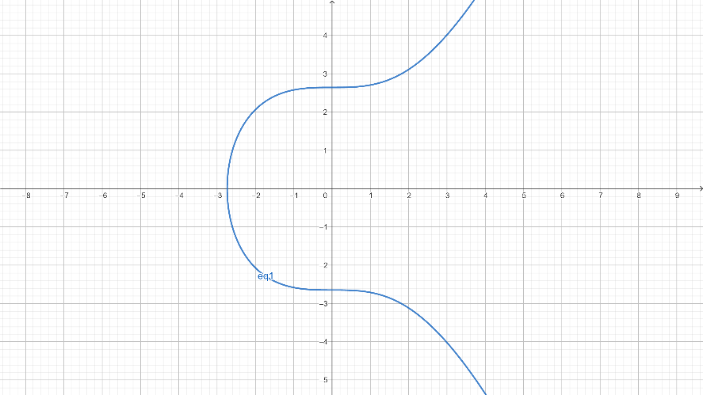
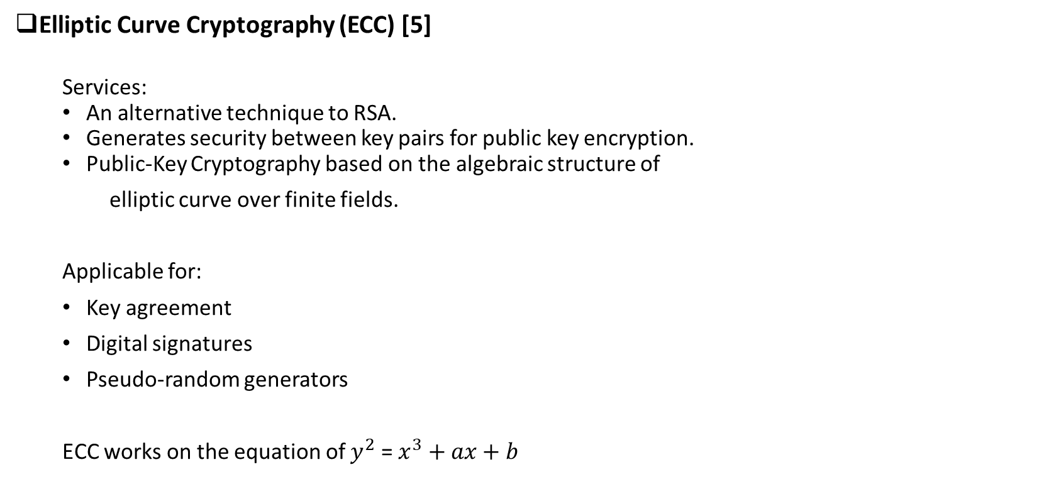
Required Tools
Elliptic Curve Cryptography (ECC) [5]
Services:
An alternative technique to RSA.
Generates security between key pairs for public key encryption.
Public-Key Cryptography based on the algebraic structure of
elliptic curve over finite fields.
Applicable for:
Key agreement
Digital signatures
Pseudo-random generators
ECC works on the equation of $y^{2}$ = $x^{3}+ax+b$
Figure 3: Elliptic Curve Field on X-Y axis

Slide 10
Required Tools (Cont.)
ECC vs. RSA [1]
ECC is typically more appropriate for usage in resource-constrained devices and real- time applications, while RSA is more popular and well-established.
ECC | RSA
160 | 1024
256 | 3072
384 | 7680
Table 2: Comparison of number of bits used in ECC and RSA to get same security

Slide 11
Required Tools (Cont.)
El-Gamal Signature Scheme [2]
Digital signature scheme which is based on discrete logarithms.
Works on signing and verification a signature for authentication.
Operations:
Key Generation
Signing
Verifying Signature

Slide 12
Required Tools (Cont.)
Bit Manipulation
Manipulate of bits in key.
Hard to get back to original value.
Operations :
Bit-wise OR
Bit-wise AND
Bit-wise XOR

Slide 13
Proposed Methodology
Consists of 2 phases :
Initialization
Authentication

Slide 14
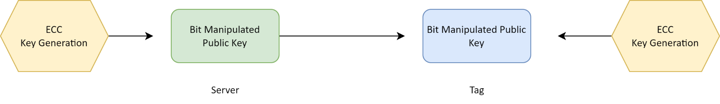
Proposed Methodology (Cont.)
Initialization : 2 steps.
Server side
Private key s, m.
Public key P = sQ, R = mQ.
M = P&R.
Send M to Tag.
Tag side:
Private key t.
Pt = tQ.
A = Pt U M.
T = A+tA.
Store T, Pt for further authentication.
Figure 5: Initialization Phase

Slide 15
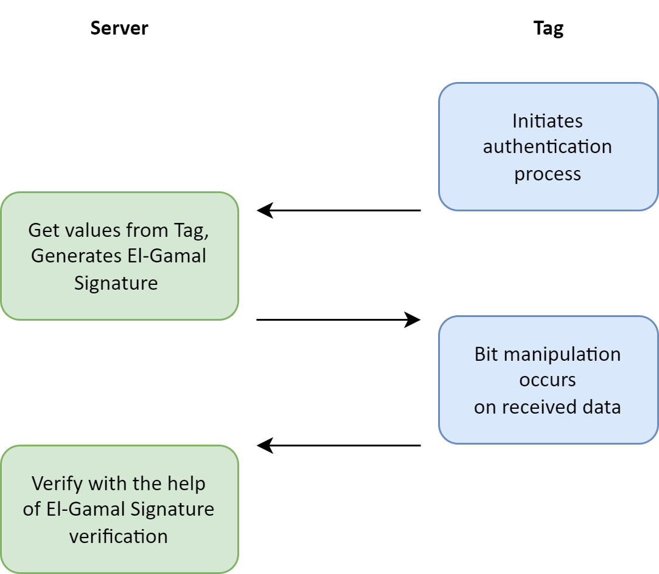
Proposed Methodology (Cont.)
Authentication : 4 steps.
Tag side:
Send T, Pt to server
Server side:
A’ = Pt U M
Sg, Rg = El-Gamal_signing(T, A’)
Send Sg,Rg to Tag.
Figure 6: Authentication Phase

Slide 16
Proposed Methodology (Cont.)
Authentication : 4 steps ( Cont.)
3) Tag side:
B = A U (Sg & Rg)
N = B Ꚛ T
Send N to Server.
4) Server side:
B’ = A’ U (Sg&rg)
T’ = N Ꚛ B’
Sg’, Rg’ = El-Gamal_ signing(T’, A’)
El-Gamal_Signature_Verification(Sg, Rg)=? El-Gamal_Signature_Verification(Sg’,Rg’)
If it gives true, authentication successful. Else aborts.

Slide 17
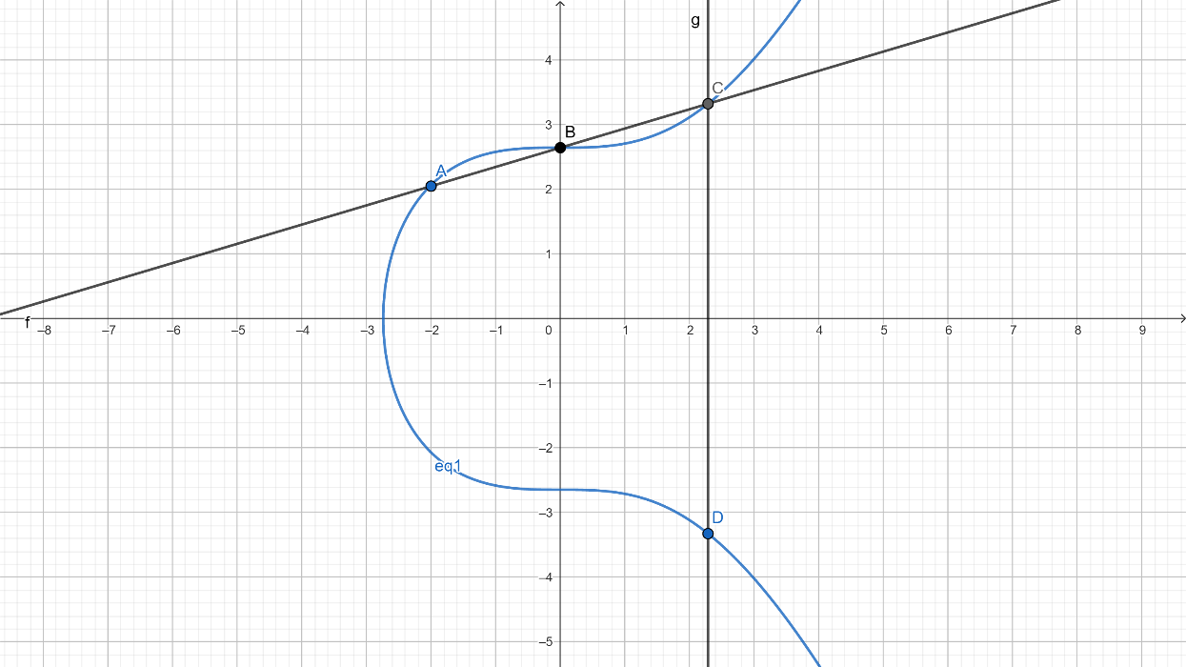
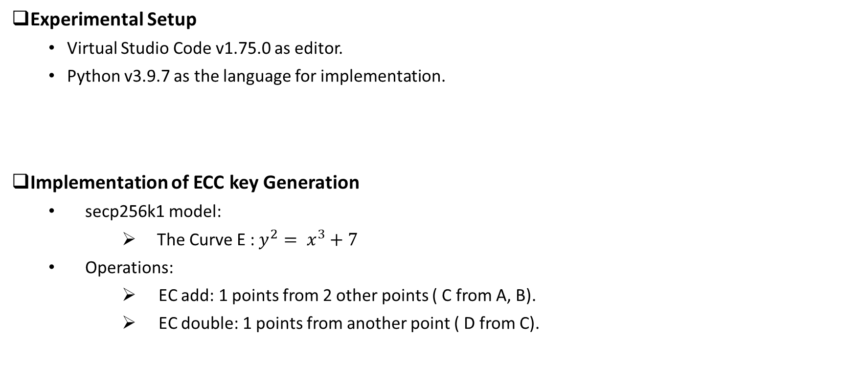
Prototype Evaluation
Experimental Setup
Virtual Studio Code v1.75.0 as editor.
Python v3.9.7 as the language for implementation.
Implementation of ECC key Generation
secp256k1 model:
The Curve E : $y^{2}= x^{3}+7$
Operations:
EC add: 1 points from 2 other points ( C from A, B).
EC double: 1 points from another point ( D from C).
Figure 7: ECC key Generation

Slide 18
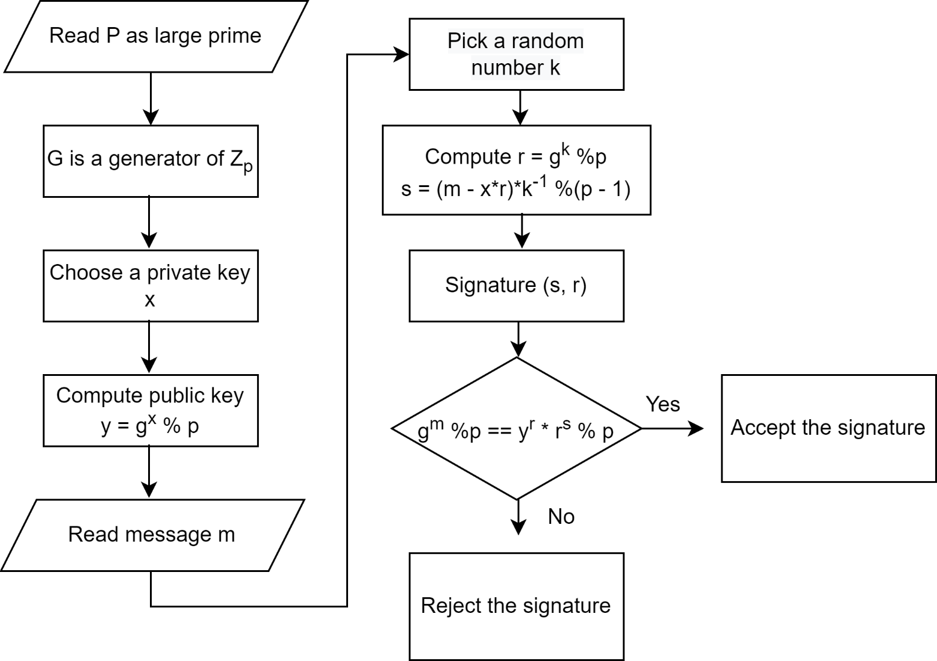
Prototype Evaluation (Cont.)
El-Gamal Signature Verification
Figure 8: El-Gamal Signature Verification Flow Chart

Slide 19
Prototype Evaluation (Cont.)
Experimental result:
Server/Tag | Input | Output | Verification Flag
Server | s=11702, m=420838 | M=(14898407060415365318833651937377610736450856238805031296572380833665937514507, 8428029595295141819710846202898226591463894600414531680) | _
Tag | M=(14898407060415365318833651937377610736450856238805031296572380833665937514507, 8428029595295141819710846202898226591463894600414531680)
Table 3: Initialization

Slide 20
Prototype Evaluation (Cont.)
Experimental result (Contd.):
Server/Tag | Input | Output | Verification Flag
Tag | _ | T = (31402154390291296585544318237240999221496876548904019805738349073645563392617, 22118421386738260585145428721121976033837693318874135222) Pt = (28751087112865646778086692018893182533227425746203364377961037924259350908980, 31046895123409507066835593899898841849119765084328489485) | _
Server | T = (31402154390291296585544318237240999221496876548904019805738349073645563392617, 22118421386738260585145428721121976033837693318874135222) Pt = (28751087112865646778086692018893182533227425746203364377961037924259350908980, 31046895123409507066835593899898841849119765084328489485) | S = 609171286931842029798951241489981406174479674784099060358173980863350155702515901428201120306633161989796370723222631803427801601681737526029515761343628575907 r = 495228472803037347165935762239576668030441977287935527988119465928465376294239430984752198409906680736063260771279984955777151082726644524 | _
Table 4: Authentication (step 1-2)

Slide 21
Prototype Evaluation (Cont.)
Experimental result (Contd.):
Server/Tag | Input | Output | Verification Flag
Tag | s = 609171286931842029798951241489981406174479674784099060358173980863350155702515901428201120306633161989796370723222631803427801601681737526029515761343628575907 r = 495228472803037347165935762239576668030441977287935527988119465928465376294239430984752198409906680736063260771279984955777151082726644524 | N = 495151271918230444297773601852020715881757951045683734898095785071696353676495322808793454949939387718724804804505956277722746846071652950 | _
Server | N = 495151271918230444297773601852020715881757951045683734898095785071696353676495322808793454949939387718724804804505956277722746846071652950 | _ | True
Table 5: Authentication (step 3-4)
Successful authentication as no change occurs in the mid time of authentication.

Slide 22
Prototype Evaluation (Cont.)
Experimental result (Contd.):
Server/Tag | Input | Output | Verification Flag
Tag | s = 609171286931842029798951241489981406174479674784099060358173980863350155702515901428201120306633161989796370723222631803427801601681737526029515761343628575907 r = 495228472803037347165935762239576668030441977287935527988119465928465376294239430984752198409906680736063260771279984955777151082726644524 | N = 495151271918230444297773601852020715881757951045683734898095785071696353676495322808793454949939387718724804804505956277722746846071652950 | _
Server | N = 495151271918230444297773601852020715881757951045683734898095785071696353676495322808793454949939387718724804804505956277722746846071652960 |  | False
Table 6: Authentication (step 3-4)
Failed authentication as change occurs in the mid time of authentication of value of N at step 3 to 4.

Slide 23
Prototype Evaluation (Cont.)
Security Issues Comparison:
Server Spoofing Attack:
An attack gives an attacker the ability to pose as a legitimate system user. The attacker poses as a reader, requests information from a tag, and then receives the tag’s answer.
70 digits long number of private key, data stored in server during registration by authorized person, unauthorized user can’t access the server easily.
Position Tracking Attack:
Can’t be easily accessed private keys and calculated value of Tag’s A or value of Server’s A’.
Anonymity:
As no position tracking attack and server spoofing attack occurs, anonymity of tag keeps secured.

Slide 24
Conclusions
In other related works, authors proposed modular-exponential , ECC only, ECC with hashed based key generation. Where occurs some attacks and problems such as anonymity, server spoofing attack and position tracking attacks.
Compared to previous techniques, the combination of ECC, bit manipulation, and El-Gamal signature offers a stronger and more effective security solution for RFID authentication.

Slide 25
Limitations
As 70 digits long number for private key, challenge for tag side to calculation. Needs power.
It might not consider other important aspect of RFID authentication. As there could be scenarios of supply chain management, inventory management, retail store etc.
Assumed data leaking wouldn’t occur in storage.

Slide 26
Future Works
Real-world deployment to assess its applicability and efficacy in a real-world setting, integration with other technologies, such as biometrics or blockchain.
More tag at a time by storing data for managements.
To make sure the protocol works with a variety of systems, it can be tested using various RFID devices and readers.

Slide 27
References
[1] Ecc vs rsa: Comparing ssl/tls algorithms. https://cheapsslsecurity.com/p/ecc-vs-rsa-comparing-ssl-tls-algorithms.
[2] El-gamal digital signature sheme. https://en.wikipedia.org/wiki/ElGamal_signature_scheme
[3] Radio-frequency identification. https://www.energyshow.com.cn/EN/Co/?CID=13&AID=3
[4] secp256k1. https://en.bitcoin.it/wiki/Secp256k1
[5] Elliptic-curve diffie–hellman, Feb 2023. https://en.wikipedia.org/wiki/Elliptic-curve_Diffie_Hellman
[6] Souhir Gabsi, Yassin Kortli, Vincent Beroulle, Yann Kieffer, Areej Alasiry, and Belgacem Hamdi. Novel ecc-based rfid mutual authentication protocol for emerging iot applications. IEEE access, 9:130895–130913, 2021.
[7] Muhammad Naeem, Shehzad Ashraf Chaudhry, Khalid Mahmood, Marimuthu Karuppiah, and Saru Kumari. A scalable and secure rfid mutual authentication protocol using ecc for internet of things. International Journal of Communication Systems, 33(13):e3906, 2020.
[8] Lijuan Zheng, Yujuan Xue, Linhao Zhang, and Rui Zhang. Mutual authentication protocol for rfid based on ecc. In 2017 IEEE International Conference on Computational Science and Engineering (CSE) and IEEE International Conference on Embedded and Ubiquitous Computing (EUC), volume 2, pages 320–323. IEEE, 2017.

Slide 28
Thank you
Any Question?

